Slide 1
Retail Trends
By LIU SHAOMIN
LU ZHIHAO
MEKALA HOSUR
MICHAEL NG
MING YIFAN
Notes:
HI everyone, our team will be presenting to you our interpretation of the hackaton data, brought to you by myself, ZhiHao, Mekala, Michale and YiFan

Slide 2
TABLE OF CONTENTS
1
2
3
4
Introduction
Our customers
Data & Goals
RFM modeling & Market Basket Analysis
Strategy
Conclusion
Insights and Recommendations
Evaluation
Notes:
We willl first …
Then we will go through some of the analusis we have done using the concept learnt in the past two weeks
Afterwhich we will present on some of the strategies we would deploy to achive our goal
And finally we will present some metrics to measure success and expectations that we hope to achieve at the very end

Slide 3
01
Introduction

Slide 4
Goal
Identify opportunities to maximize revenue from customers
Notes:
This analysis is done from segmenting the customers and making use of the charateristics of each clusters, derived from RFM and MBA

Slide 5
SUMMARY OF
DATA
What does our data look like?
Customers: 3232
Timespan: 6/2017 - 6/2020
Regularity: Customers must have visited the store at least 3 times
Visit: All single day transactions count as 1 visit
Notes:
Here are some of the simple information about the data we have,

Slide 6
ASSUMPTIONS
Observation | Assumption | Treatment
Zero volume & pack size | Error entries | Removed entries
Zero Spend rows | Customer received discounts and free gifts from store | Included into calculations
Multiple entries on the same day from the same customer | Same visit with multiple purchase | Grouped as a single visit
Notes:
Show that opportunity to cross sell group blue is there as they have small basket size and also effectiveness of upselling due to high frequency of group blue and green
what is more interesting are the observations and assunotions that we have made to proceed with our analysis
Should we say how many entries were removed?
…
Here we have some observations and assumptions we have made to proceed with our analysis, basically we have seen some zero values in the data, and we have justifications on why we keep them and why we remove them, the details of which can be found in our report.
I want to mention that we have observe multiple entries of the same customers on the same day, meaning to say each row of data in the data does not represent one visit to the shop, but it is representing one item purchased on a single visit; hence we should grouped all purchases on the same day from the same panel ID as a single visit.
we assume these rows to be the visit from the same customer.

Slide 7
RFM SEGMENTATION
Recency
Frequency
Monetary
Geometric mean of the days to the last 3 purchases
The number of recorded visits to the store
The average amount spent per visit
Notes:
I also want to ellaborate on how we define our RFM model, if we use the absolute number of days to the most recent visit, nearly 80% of the cusotmers will fall in the top 25%, this defeats the purpose of segementing the customers if we cant differentiate them.
Therefore we choose to find the number days to the most recent three purchases, and take the geometric mean of the 3 days to compute a score for recency. As such we will be able to penalise the customer who has their recent three visits further apart, hence able to dinstiguish the customers.
Using this method, we manage to produce a smoother distribution of customers on the recency scores.
The defnition of Frequency and monetary does not defer much from the conventional practice.
I will then pass my time to Mekela to tell us more about our segmentations

Slide 8
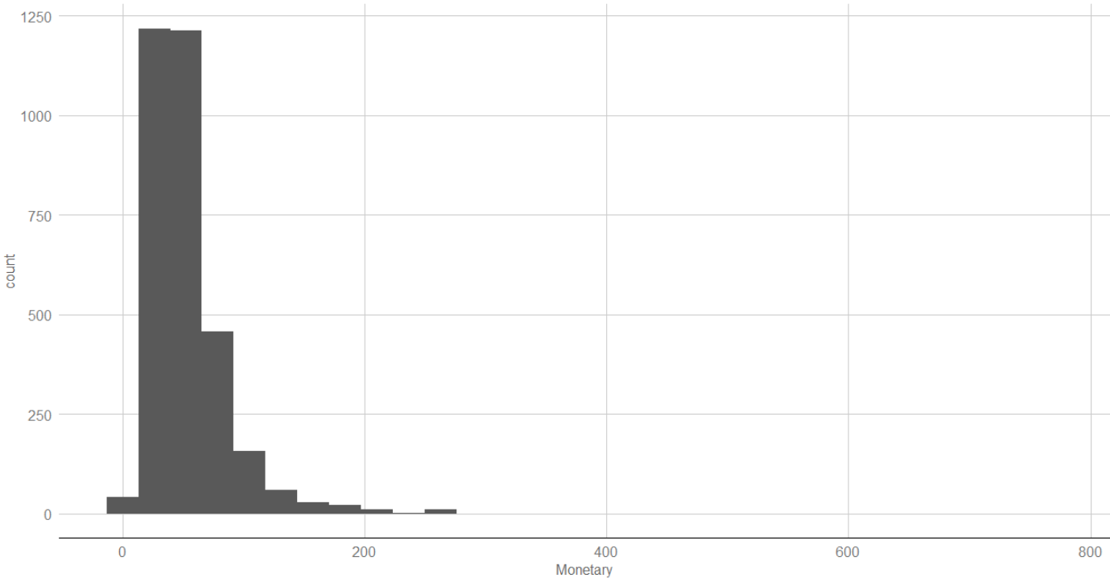
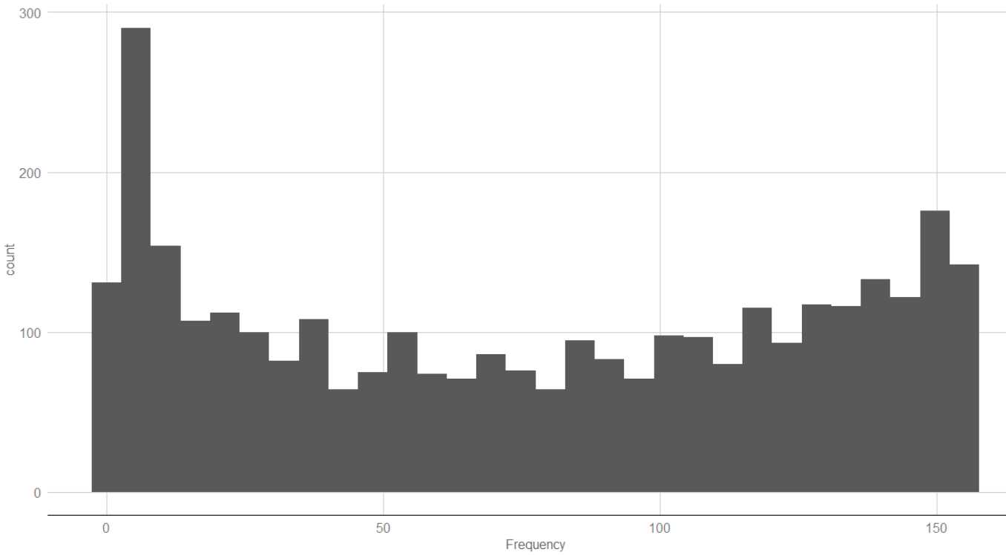
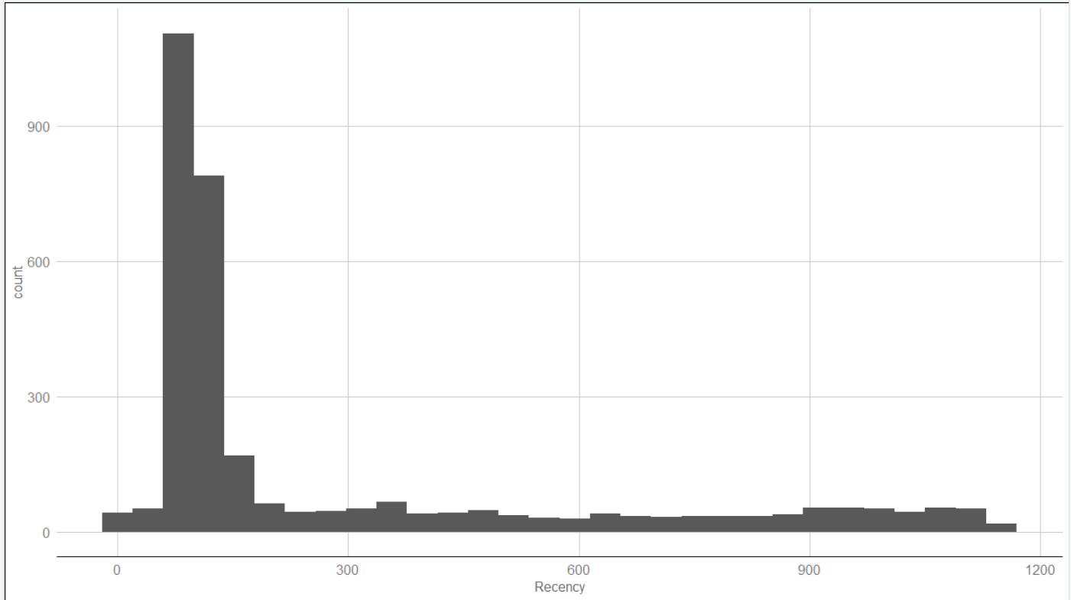
DISTRIBUTION OF RFM
Recency
Geometric mean of the days to the last 3 purchases

Slide 9
DISTRIBUTION OF RFM
Frequency
The number of recorded visits to the store

Slide 10
DISTRIBUTION OF RFM
Monetary
The average amount spent per visit

Slide 11
02
Our Customers

Slide 12
OUR CUSTOMERS
Best Customers
Low-Spending Loyalists
New Customers
Churned
Loyalists
Potential Loyalists
At-Risk
Lost
RFM
RFM
RFM
RFM
Excels in everything
Low in average basket spend
Very recent, Low F + Low M
Low R, used to moderately frequent and spent moderate amounts
RFM
RFM
RFM
RFM
RFM
Low in everything
Moderate-High R + Moderate-High F
Moderate in everything
At-risk of Churning
Either Low M + Moderate F or Low F + Moderate M

Slide 13
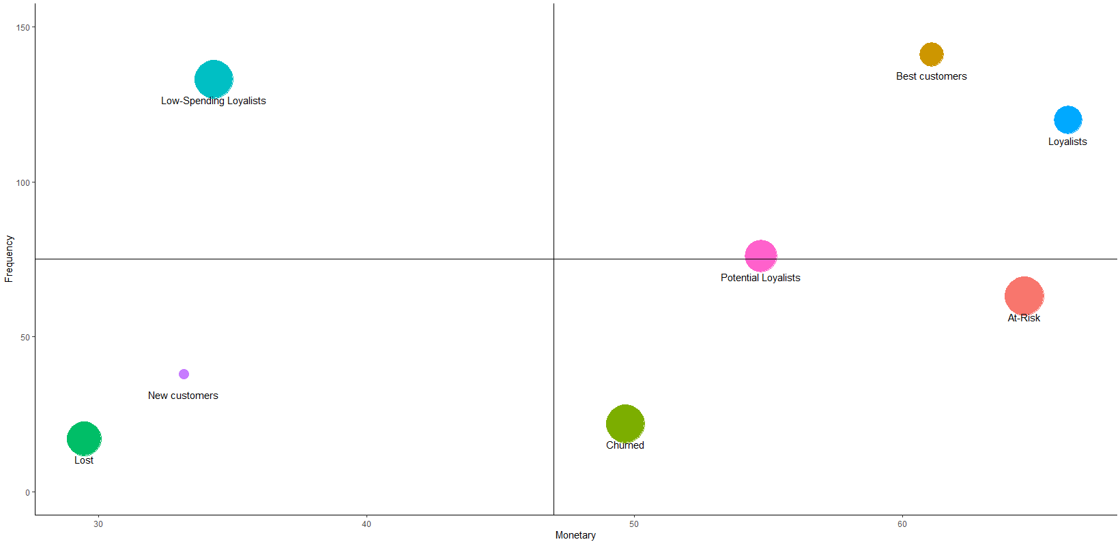
OUR CUSTOMERS
HIGH FREQ, HIGH MONETARY
LOW FREQ, LOW MONETARY
Notes:
Lost and Churned have very poor recency so the focus is on the other 6 groups that have similar recency scores.
Adjust the label font size

Slide 14
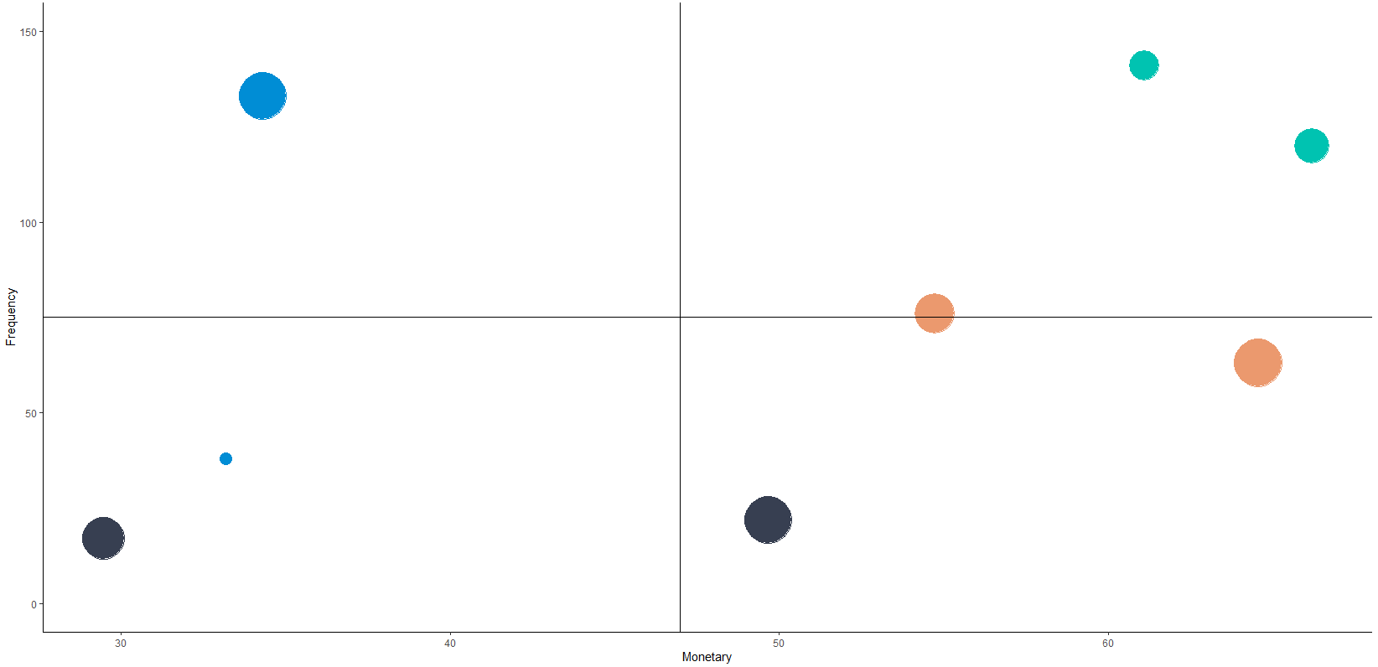
OUR CUSTOMERS
HIGH FREQ, HIGH MONETARY
Best
Low Spending Loyalists
Loyalists
LOW FREQ, LOW MONETARY
Potential Loyalists
At-Risk
New
Lost
Churned
Maintain relationship
Increase purchase value
Increase frequency and retain interest
Notes:
Goals for each group: Blue - low-spending loyalists, new customers
Green- best, loyalists
Orange - potential loyalists, at-risk

Slide 15
03
Strategy

Slide 16
LOYALTY
PROGRAM
Loyalty
Upselling
Impression
Cross Selling
Continue current consumption habits
High frequency magnifies effectiveness
Turning customers into ambassadors
Increase average basket size

Slide 17
UPSELLING & CROSS-SELLING
Segment | Avg Basket Size | Price per Item | Frequency
Best customers | 6.97 | $8.77 | 141
Loyalists | 6.61 | $10.00 | 120
Potential Loyalists | 5.89 | $9.30 | 76
At-Risk | 5.82 | $11.07 | 63
Low-Spending Loyalists | 3.90 | $8.80 | 133
New customers | 3.67 | $9.02 | 38
Notes:
Show that opportunity to cross sell group blue is there as they have small basket size and also effectiveness of upselling due to high frequency of group blue and green.
Low-spending-loyalist average
Low-spending loyalty + new customers

Slide 18
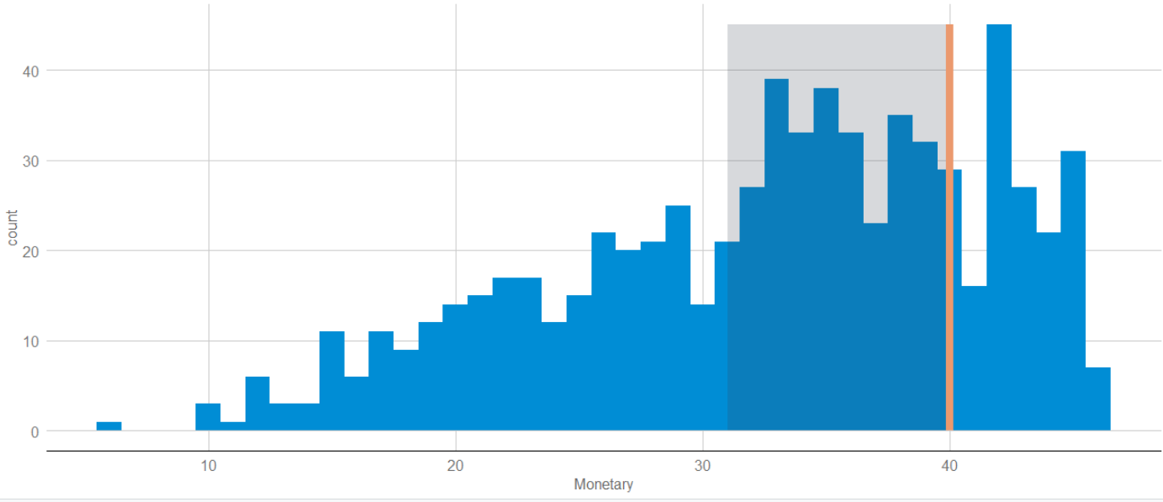
Minimum spending
Notes:
From previous slide we identify that consumers in group blue have an average basket price of $9, so seeing that there is a drop off in monetary value near the $40 mark, if we set a goal of $40, there is a large group of customers that are within 1 item away from hitting that goal. (depicted in the grey box)

Slide 19
What should be advertised?
Identifying which products to choose to attract certain consumers
Notes:
As Zhihao has mentioned, a large group of customers are only 1 items away from hitting the goal.
So to reach this goal, we should advertise on the products that attract our targeted customer.

Slide 20
Consumption Habits based on historical records
How to identify which products attract certain customer?
Panel ID | Item | Frequency | Average Spend | Standard Spend/Vol
101011101 | Biscuits | 16 | 18.78 | 15.57
101011101 | Cake | 3 | 18 | 31.97
801912801 | MSG | 2 | 22 | 19.02
Notes:
So now the question becomes what attract customer. The simple assumption is customer may buy items they have bought in the past and items they have spent more on. This is there consumption habits.
Here are 2 examples. The first personal spends 18.78 each time on average during 16 purchasing. So it is obvious that this customer likes Biscuits much more than cake.

Slide 21
VARIANCE IN AVERAGE
PURCHASE PRICE
Targeted advertising based on understanding of product purchasing habits by demographics: Segment, BMI, Income, Ethnicity, Life Stage, Strata, Members, Loc
What may customers like to buy?
Notes:
However, the certain customer’s habits only based on his historical records. With only few records, the advertisement may not be useful. So the other method is to advertise based on demographics. If other customer in this segment are willing to pay for an item, targeted customers have high chance to buy it as well.

Slide 22
Consumption Habits by Segments
Segment | Cake | Margarine
Best customers | 0.19 | 0.66
Loyalists | 0.16 | 0.63
Potential Loyalists | 0.13 | 0.40
At-Risk | 0.13 | 0.40
Churned | 0.08 | 0.28
New Customers | 0.09 | 0.23
Notes:
Recommendation: advertsie to which group with low score
This percentage numbers means 19% of best customers spend more than standard price on cake.
The higher percentage shows the stronger willingness to buy premium products with higher price.
It is clear to see that consumption habits vary among different segments, and this also happen among other features such as income and location.

Slide 23
Consumption Habits of Best Customers
Segment | Top 5 Items that Willing to spend more on | Top 5 Items that Willing to spend less on
Best customers | Instant Noodles, Biscuits, Condensed/Evap Milk, Cooking Sauces, Tea | Belacan, Spirits, Energy Drinks, Wine, Bird Nest
Notes:
Here we used Best customers as an example, If the customer has not bought things from popular items list of his segment, we can advertise these items. Comparing with advertising on Energy Drinks, advertising on Biscuits towards Best customers is a more efficient way to increase revenue.

Slide 24
ITEMS BOUGHT BY GROUP BLUE
Item | Support
Eggs | 0.309
Biscuits | 0.241
Rice | 0.189
Sugar | 0.182
Cooking Oils | 0.175
Notes:
New customers - 3.67
Low spending - 3.90

Slide 25
INCREASING BASKET SIZES
By bundling items with high support with those that have low support, we can entice customers to add more items into their baskets, hence increasing the average basket sizes.
Antecedent | Consequent | Lift
(Condensed/Evap Milk, Cooking Sauces, Rice) | (Sugar) | 3.39
(Cooking Sauces, Rice, Sugar) | (Condensed/Evap Milk) | 2.90
Notes:
Lift is an important metric to determine whether a customer will buy the bundle, given seeing the high support item inside the bundle
What we hope to achieve is to increase the average basket from 4 to 5 which is a 25% increase.

Slide 26
04
Conclusion

Slide 27

Loyalty Programme
1.
Targeted Advertising by Segments
2.
Increasing Minimum Expenditure
3.
Bundling to increase basket size

Slide 28
$386,870
35%
By promoting our BLUE to ORANGE
And ORANGE to GREEN
Increase in Quarterly Revenue

Slide 29
Thanks!
Do you have any questions?
Please keep this slide for attribution.

